Slide 1
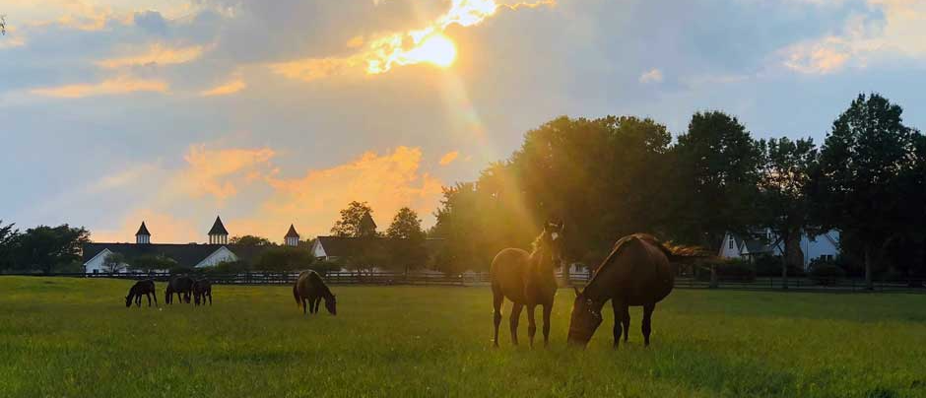
New Jersey Sire Stakes
BREEDERS GUIDE

Slide 2
Perfect Sting Pacer 3, 1:48.1M ($1,808,147) Always B Miki-Shebestingin-Bettor’s Delight Two Time Breeders Crown Champion 2020 ( 2 year old) 2021 ( 3 year old). Leading Purse Money Earner in 2021 with earnings of $1,273,847. He was named the Dan Patch 2 year old pacer of the year in 2020
STANDING AT DEO VOLENTE FARM www.deovolentefarms.com
2025 Fee $10,000

Slide 3
Ecurie D DK ($1,514,969) Infi6, 1:49.1 M Infinitif - To Soon - Muscles Yankee In May of 2022, in his first start of the year, he won the Cutler Memorial at the Meadowlands in 1:49.1 – a world record and the fastest mile ever trotted in May in harness racing history.
STANDING AT SOUTHWIND FARM www.southwindfarms.net
2025 Fee - $7,500

Slide 4
Bettors Wish P, 4, 1:47.3M ($2,601,233) Bettor’s Delight - Lifetime Star - Western Ideal
Standing at Southwind Farm
www.southwindfarms.net
2025 Fee - $7,500

Slide 5
Muscle Hill 2, 1:53.3, 3, 1:50.1-'09 ($3,266,835) Muscles Yankee – Yankee Blondie – American Winner The #1 trotting sire, he led in all-age money-earnings again in 2020, with the winners of over $9.6-million. He has been the leading sire for the fifth year in a row, from 2016 to 2020.
STANDING AT SOUTHWIND FARM www.southwindfarms.net
Private Treaty

Slide 6
Tactical Landing 3, 1:50.2 M ($812,300) Bay 2015 • Muscle Hill - Southwind Serena – Varenne In 2018 at three, winner of his elimination and $500,000 Final of the Breeders Crown, the $350,000 TVG Trot Final, Bluegrass Stakes, an elimination of the Hambletonian, an elimination of the Kentucky Futurity, and a leg of the Kentucky Sires Stakes.
STANDING AT SOUTHWIND FARM www.southwindfarms.net
2025 Fee $25,000

Slide 7
Walner 3, 1:50.2 M ($567,652)Bay 2014 • Chapter Seven – Random Destiny - Ken Warkentin
A winner of 9 of 10 career starts, including 7 of 8 at two, highlighted by the Breeders Crown (elim and Final), Kindergarten Final
and the International Stallion Stake at The Red Mile, trotting to his two-year-old World Record of 2,1:51.3.
STANDING AT SOUTHWIND FARM www.southwindfarms.net
2025 Book Full and Closed

Slide 8
Legendary Hanover 2021, P, 3, 1:46.2 M $1,088,681 Huntsville – Lillian Hanover – Well Said
STANDING AT SOUTHWIND FARM www.southwindfarms.net
2025 Fee $7,500

Slide 9
Doctor Butch 2010, P, 5, 1:48.1 M $1,671,973 Art Major – Classical Yankee – Jenna’s Beach Boy
STANDING AT SUNSET RIDGE EQUINE
Cream Ridge, New Jersey
2025 Fee $3,500

Slide 10
In The Arsenal 2012, P, 3, 1:49.1M $1,035,898 American Ideal – Ladyotra – On The Road Again
STANDING AT SUNSET RIDGE EQUINE
Cream Ridge, New Jersey
2025 Fee $2,500

Slide 11
Shepherd One 2008,P,5, Q1:58.4 F, $6,276 Art Major – Cajun Silklace - Laag
STANDING AT BIRCH CREEK FARM
Cream Ridge, New Jersey
2025 Fee - Private

Slide 12
Mysterious Moment 2006 , P, 10, 1:51.0 M $471,887 Totally Western – Lover’s Talk – Life Sign
STANDING AT DORIS LAIL FARM
2025 Fee - Private

